Slide 1

Society & types
Abdullahi Mohamed Jibril
4204-FBAS-BSCS4-F19
Rahman Said
4163-FBAS BSCS4-F19
Pakistan culture & society

Slide 2

Society

Slide 3

What Is Society ?
Defining Society :
Society refers to a group of individuals who share a common territory, culture, and social structure.
It involves the interactions, relationships, and behaviors of people within a specific community, region, or nation.
Societies are characterized by social institutions, norms, values, and systems that shape individual roles and behavior.

Slide 4

Types of Society
There are main Five types of Society :
Hunter-gatherer societies
Agricultural societies
Industrial societies
Post-industrial societies
Post-modern societies

Slide 5
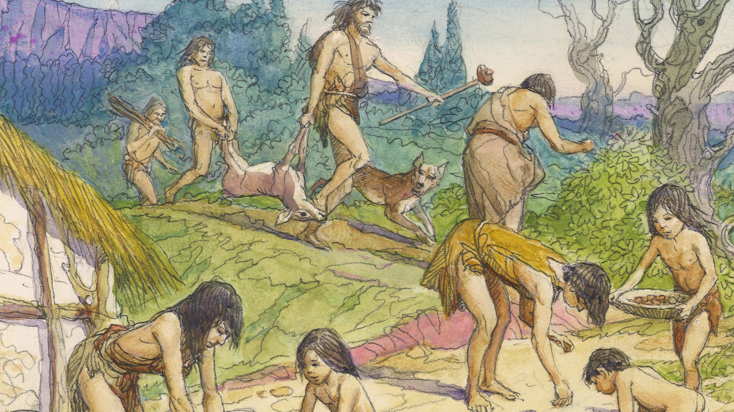
Hunter-Gathering Society
Hunter-gatherer society refers to a type of social organization in which humans rely primarily on hunting, fishing, and gathering wild plants and resources for their subsistence. It is one of the earliest forms of human societies, predating the development of agriculture and settled civilizations.
Hunter-Gather Society
One of the earliest types of societies.
Relied on hunting, fishing, and gathering for sustenance.
Typically small, nomadic, and egalitarian in nature.
Shared resources and had a close connection with nature.

Slide 6
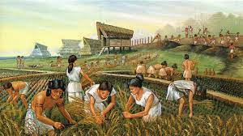
Agricultural societies
Agricultural societies are types of societies that emerged with the development and practice of agriculture. They are characterized by the cultivation of crops and the domestication of animals for food production. Here are some key features of agricultural societies:
Agri-Society :
Emerged with the development of agriculture.
Settled in one place and practiced farming.
Led to the establishment of permanent settlements.
Social hierarchies formed based on land ownership.

Slide 7
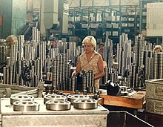
Industrial Societies
Industrial societies are types of societies that emerged with the industrial revolution, which began in the 18th century. They are characterized by significant advancements in technology, manufacturing, and mechanized production. Here are some key features of industrial societies.
Industrial-Society
Associated with the industrial revolution.
Shifted from agriculture to manufacturing and mechanized production.
Urbanization and technological advancements.
Division of labor and mass production.

Slide 8

Post-Industerial Societies
Post-industrial society, also known as a post-industrial or information society, refers to a type of society that has transitioned from an industrial economy to one driven by information, services, and knowledge. It is characterized by a shift from manufacturing-based industries to service-based industries and the widespread use of information technology
Post-Industerial Societies
Also known as information or knowledge societies.
Shifted from manufacturing to service-based industries.
Reliance on information technology and knowledge economy.
Emphasis on innovation and exchange of information

Slide 9
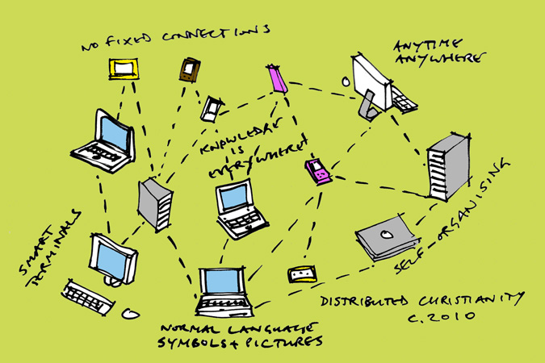
Post-Modern Society
Post-modern society refers to a type of society that emerged in the late 20th century and is characterized by a departure from modernist principles and a critical questioning of traditional norms, values, and institutions. It is marked by cultural diversity, globalization, and a blurring of boundaries between different social, cultural, and artistic expressions
Post-Modern Society :
Associated with the late 20th and early 21st centuries.
Cultural diversity and globalization.
Fluid identities and blurring of traditional values.
Questioning of established institutions and norms.

Slide 10
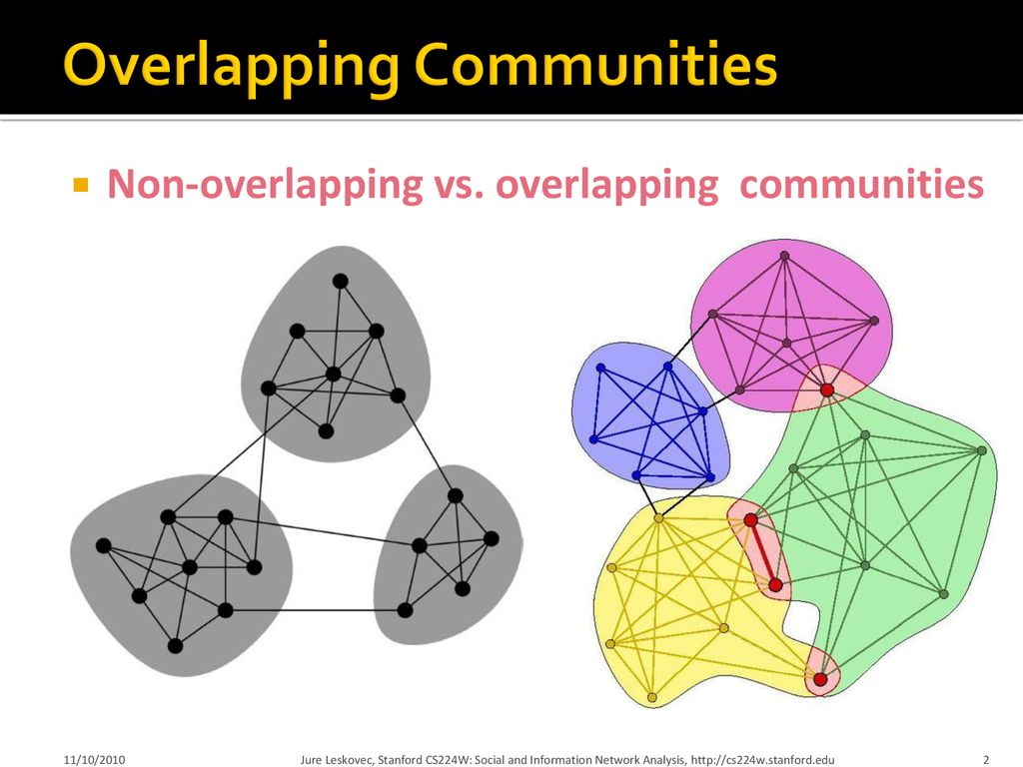
Overlapping and Transitoining Socities
Overlapping and transitioning societies refer to the idea that different types of societies can coexist within a given time period or that societies can undergo transitions from one type to another over time
Overlapping
Societies can exhibit characteristics of multiple types simultaneously.
Transition from one type to another is possible over time.
Factors such as technological advancements, social changes, and globalization influence societal shifts

Slide 11
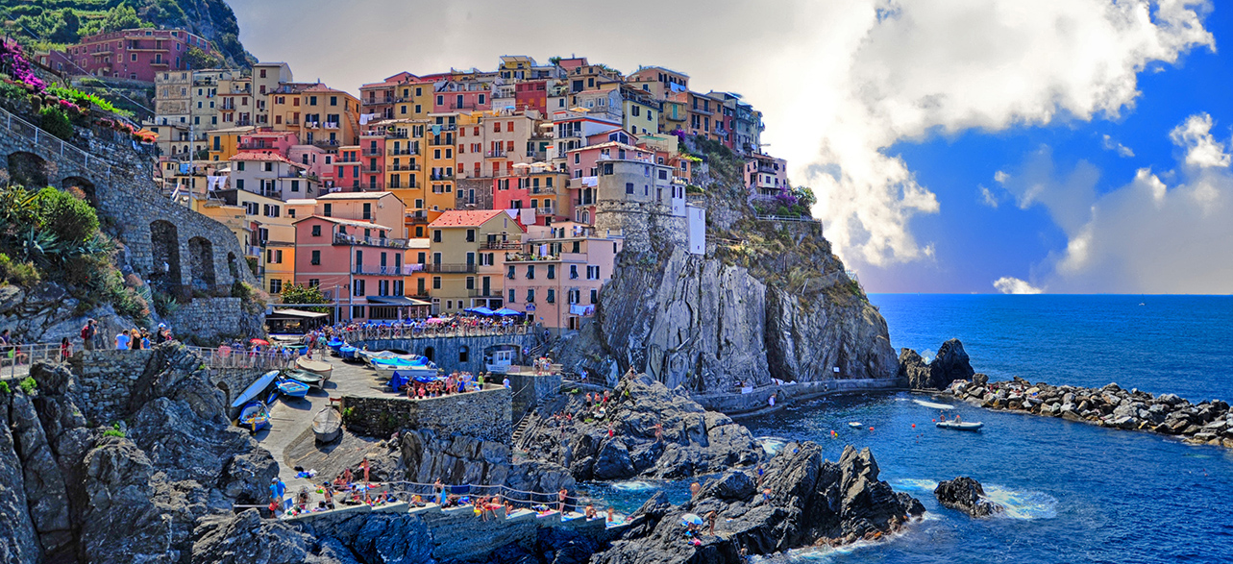
Conclusion

Slide 12
Society is a complex concept that encompasses the interactions and structures among individuals. Hunter-gatherer, agricultural, industrial, post-industrial, and post-modern societies are some commonly recognized types. These types represent different stages and characteristics of societal development. Societies can evolve and transition from one type to another.
Conclusion

Slide 13

THANK YOU!
Any Queries????

